Slide 1
X-Volt: Joint Tuning of Driver Strengths and Supply Voltages Against Power Side-Channel Attacks
Saideep Sreekumar, Mohammed Ashraf, Mohammed Nabeel, Ozgur Sinanoglu, Johann Knechtel
New York University Abu Dhabi, UAE
ISPD2023

Slide 2
Outline
Abstract
Introduction
Threat Model
Methodology
Experimental Result
Conclusion

Slide 3
Abstract
Power side-channel (PSC) attacks are well-known threats to sensitive hardware like advanced encryption standard (AES) crypto cores
Supply voltage (VCCs) has significant impact on power profiles, so lots of defensed strategy based on VCCs tuning have been proposed
Driver strengths of cell also have direct and significant impact on power profiles, but was overlook in the past
This paper proposes a novel working principle for PSC attack of jointly tuning driver strengths and VCCs
Notes:
* power profiles(功率曲線)

Slide 4
Abstract
The steps are listed below:
Develop a simple circuit-level scheme for tuning
Implement a CAD flow for design-time evaluation of ASICs, enabling security assessment of ICs before tape-out
Implement correlation power analysis (CPS) framework for thoroughly security analysis
Implement AES design in ASIC and FPGA fabrics under various tuning scenario
Summarize design guideline for secure and efficient joint tuning
Notes:
* power profiles(功率曲線)

Slide 5
Introduction – Side Channel Analysis
To protect sensitive data handled within integrated circuits (ICs), the use of cryptographic (crypto) modules is widely adopted
Once the attacker accesses to ICs, they can monitor the runtime behavior and physical interactions with the environment :
Direct : measurement
Remote/Indirect : software interface to embedded system
They can infer the secret key used for crypto modules

Slide 6
Introduction – Side Channel Analysis
PCA (power channel analysis) is one kind of SCA (side channel analysis), and it has many types:
CPA (correlation power analysis) (used in this paper!)
DPA (differential power analysis)
mutual information analysis
machine learning-based techniques

Slide 7
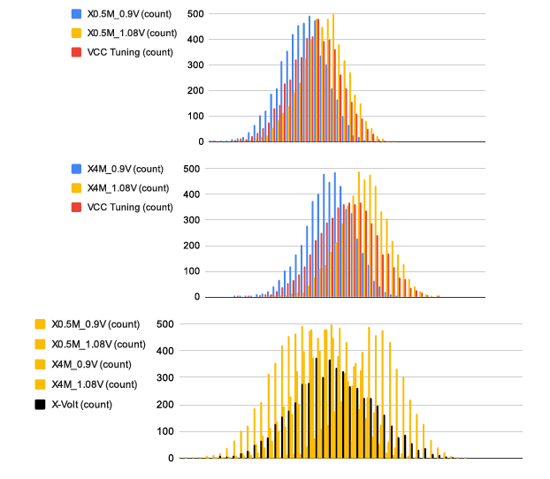
Introduction – Power Profile

Slide 8
Conclusion
In the experiment, they found that:
Runtime tuning is more effective than static tuning in both ASIC and FPGA
In FPGA, the AES core is rendered(呈現) > 11.8x as resilient as the untuned baseline design
In FPGA, layout overhead is around +10% critical path dalay in the most resilient design, which is acceptable

